Slide 1
Snowflake - Streams
Sreenivas Kalahasti

Slide 2
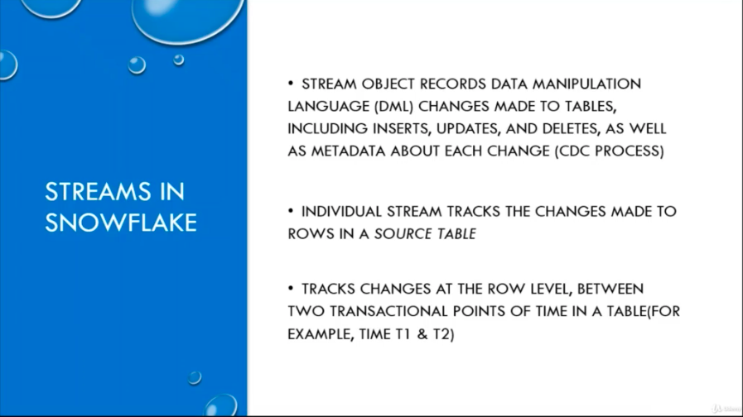

Slide 3
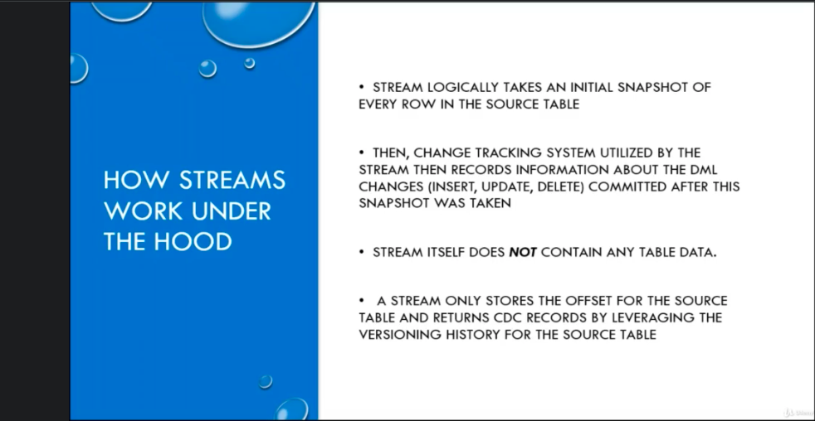

Slide 4
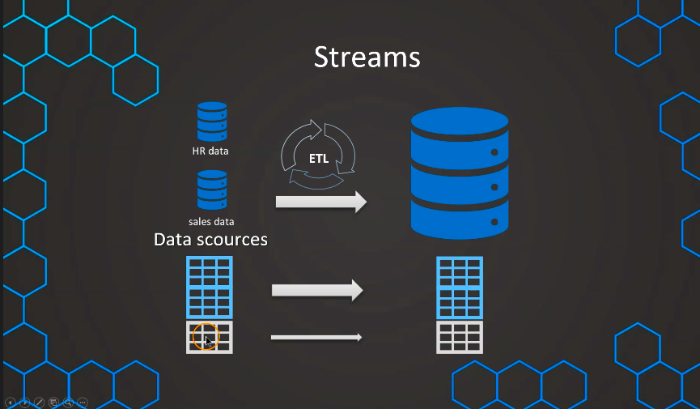

Slide 5
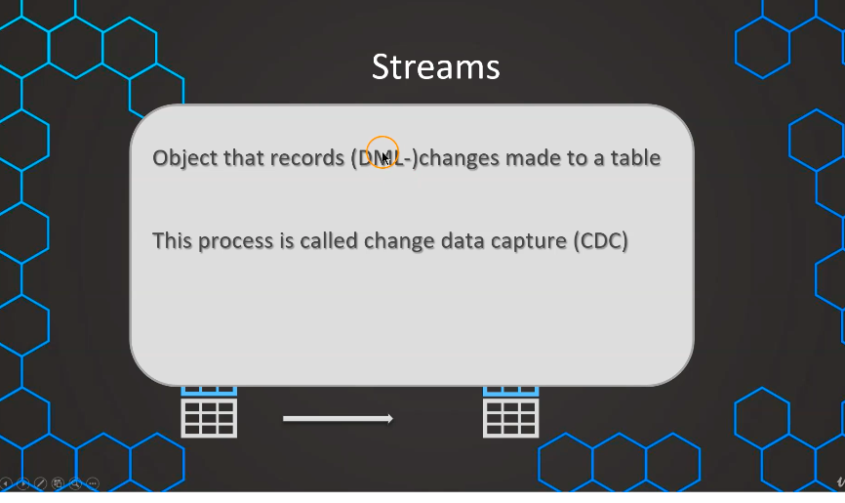

Slide 6
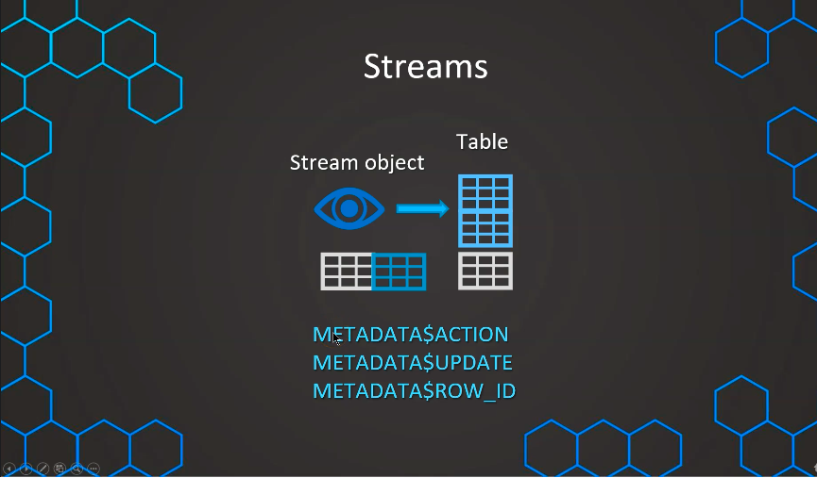

Slide 7
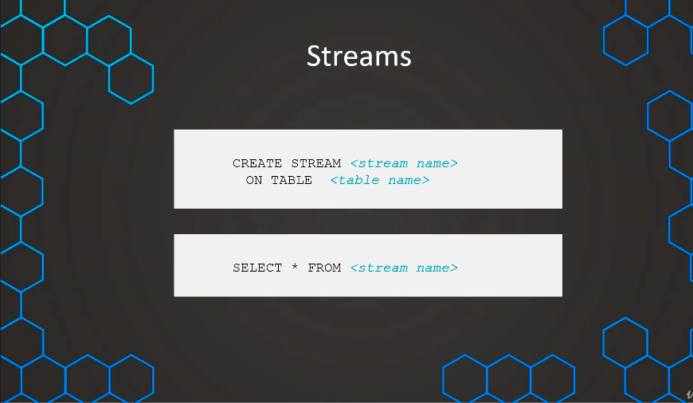

Slide 8
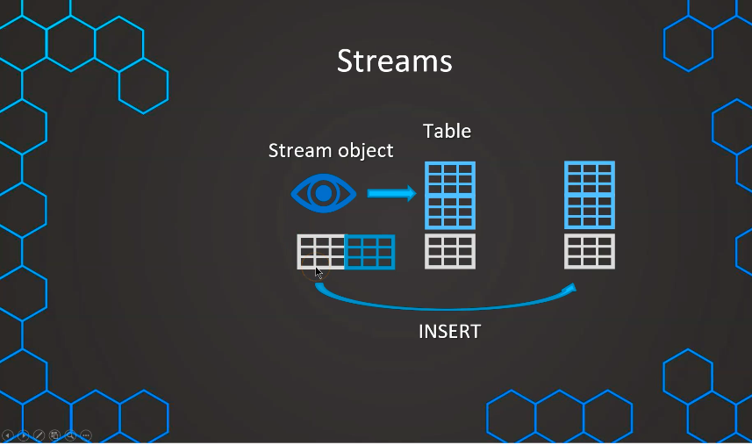

Slide 9
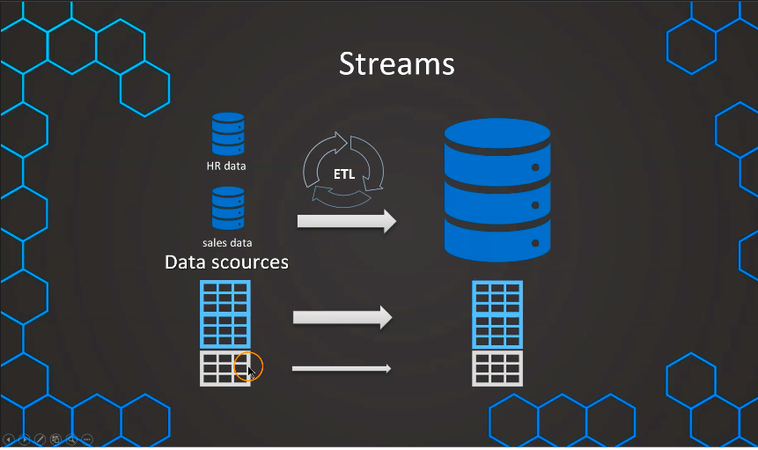

Slide 10
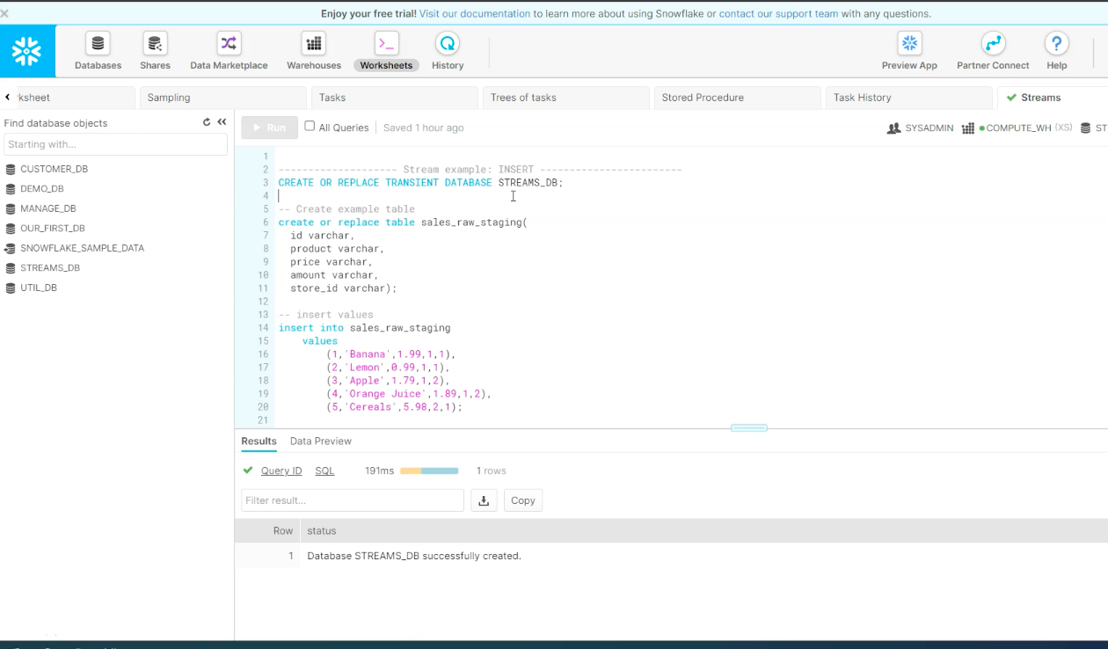
Streams - INSERT

Slide 11
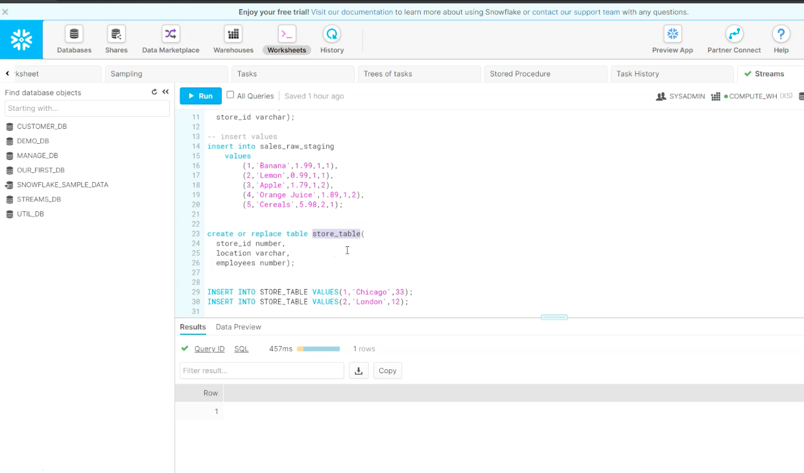
Streams - INSERT

Slide 12
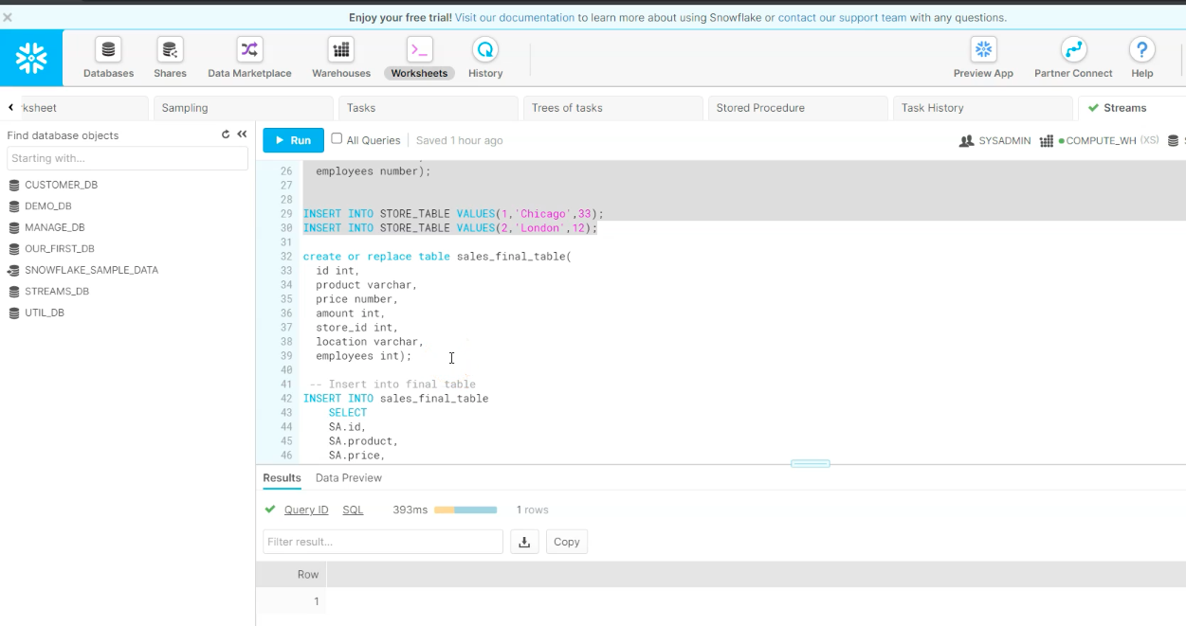
Streams - INSERT

Slide 13
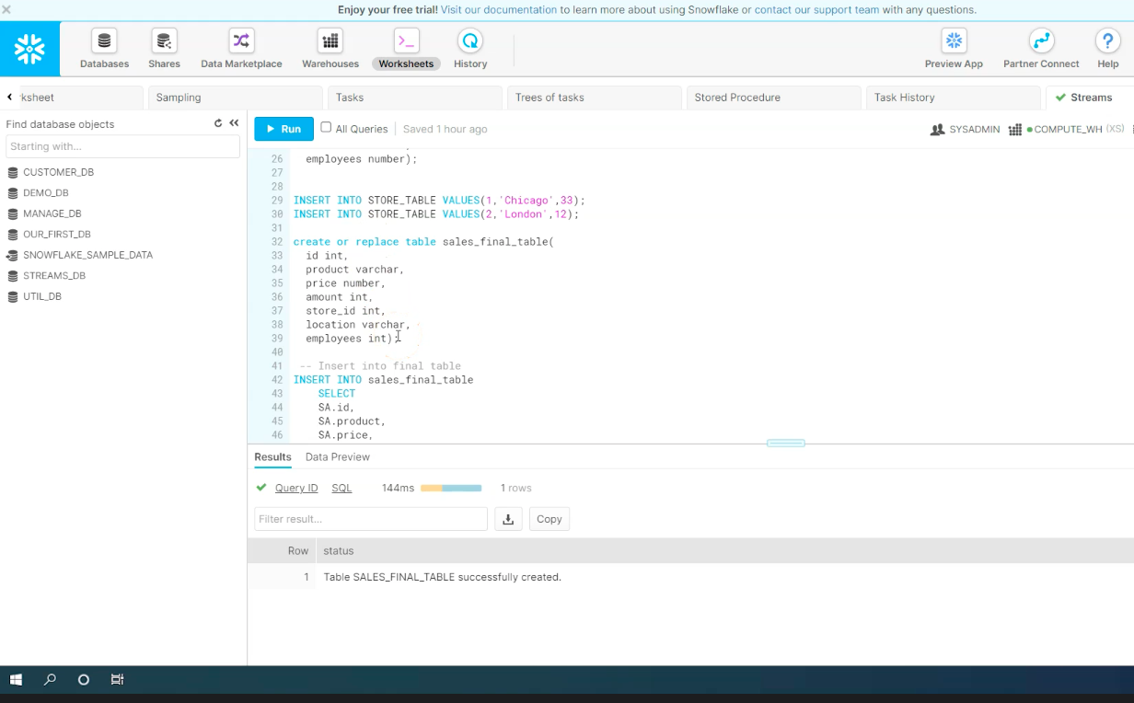
Streams - INSERT

Slide 14
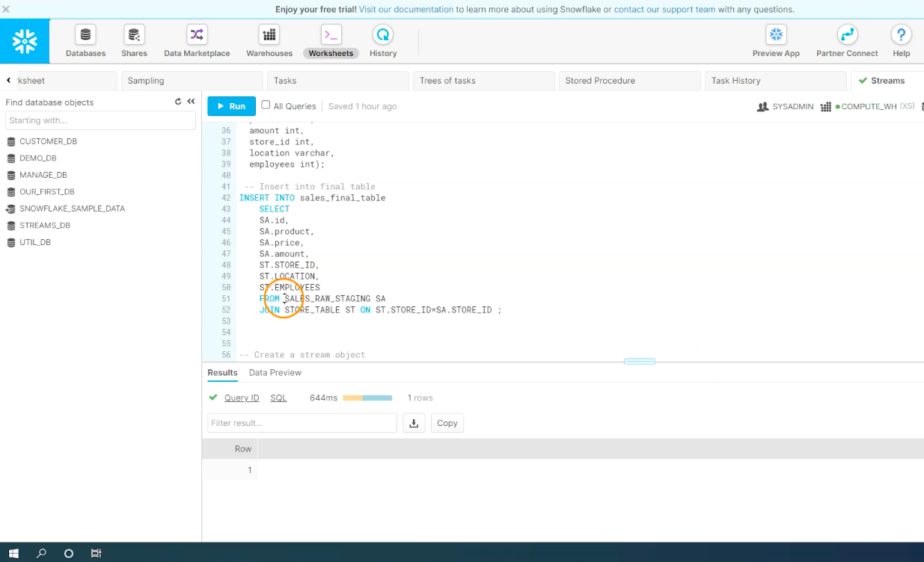
Streams - INSERT

Slide 15
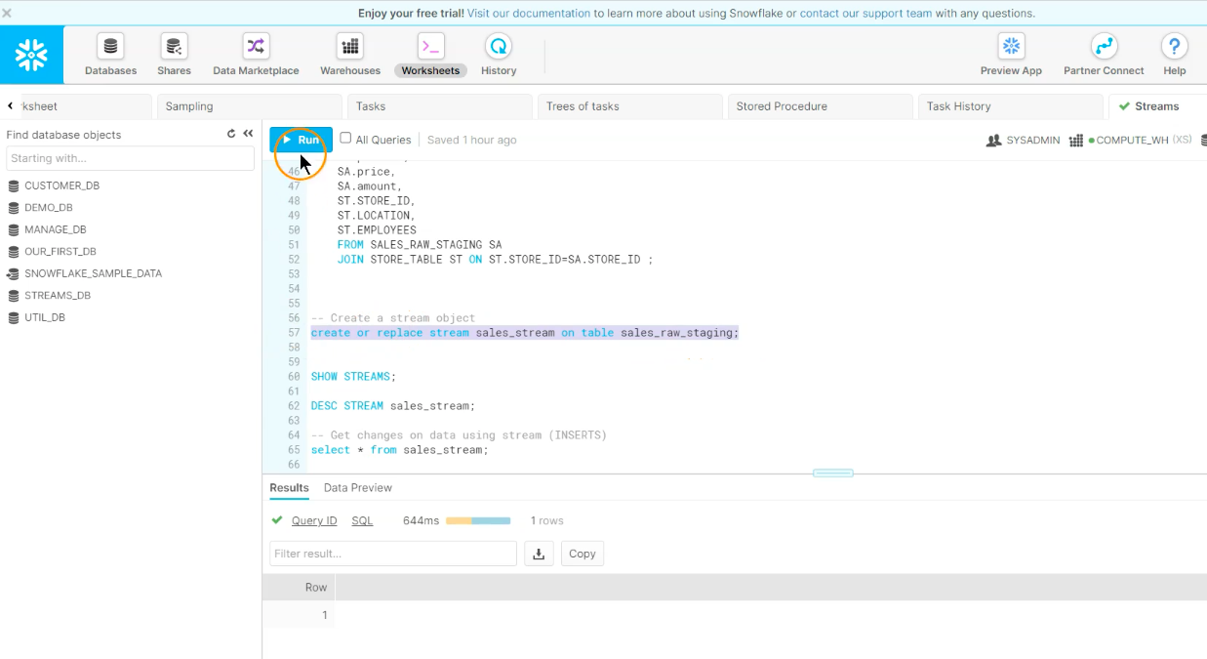
Streams - INSERT

Slide 16
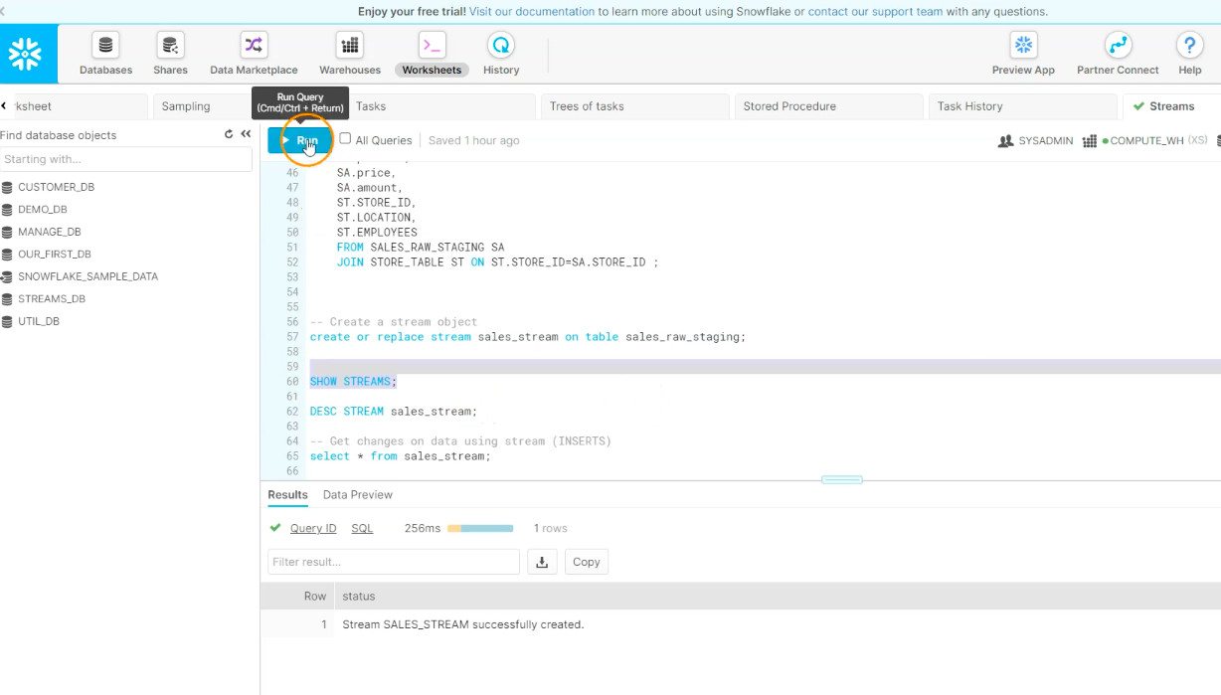
Streams - INSERT

Slide 17
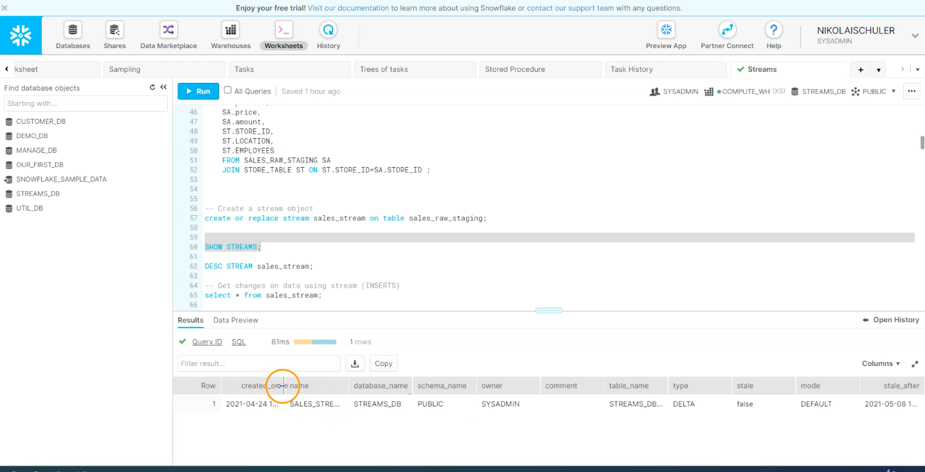
Streams - INSERT

Slide 18
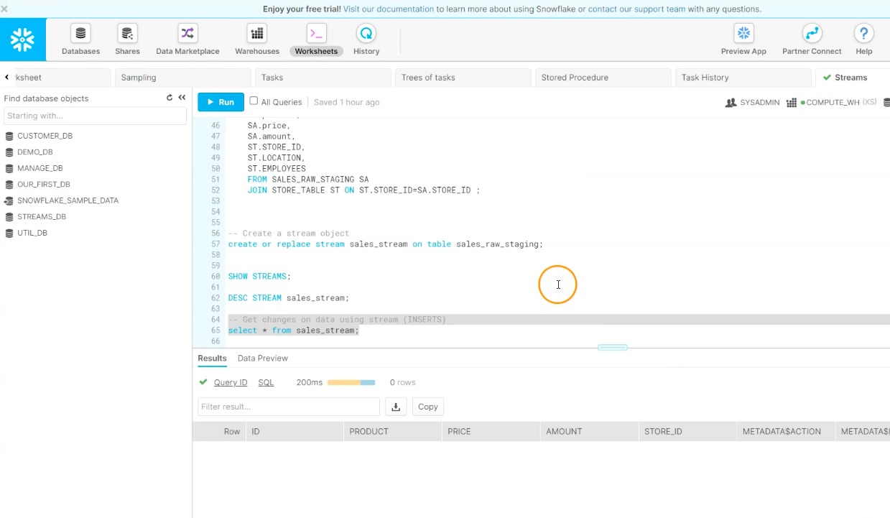
Streams - INSERT

Slide 19
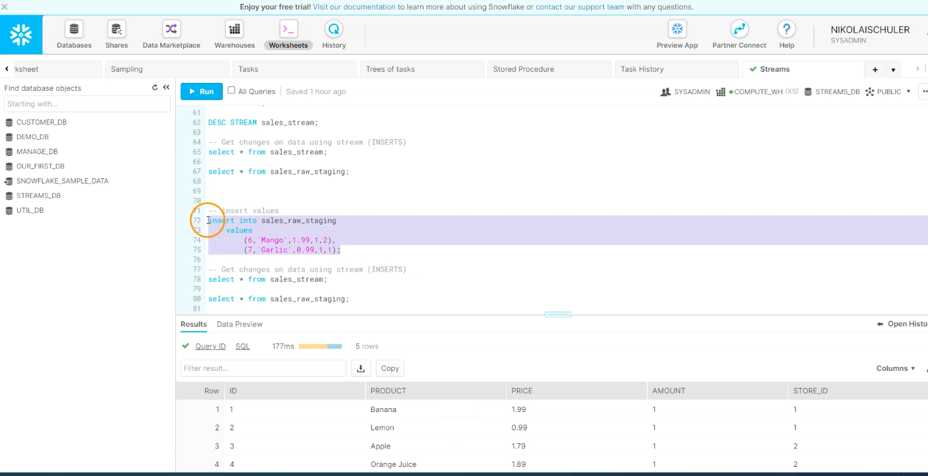
Streams - INSERT

Slide 20
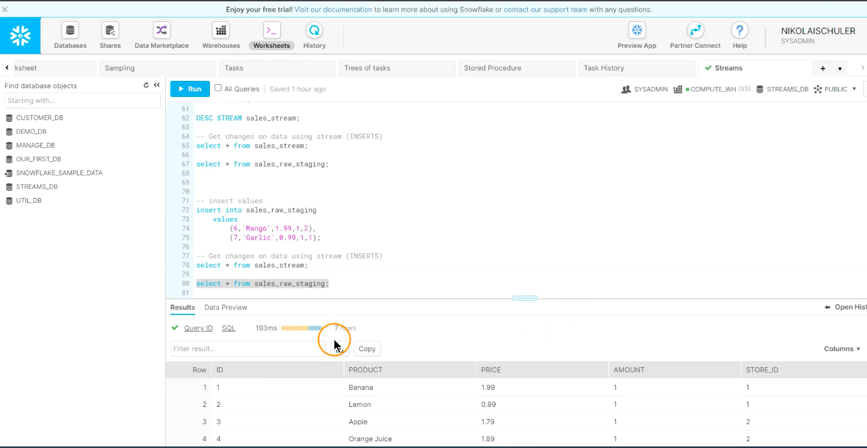
Streams - INSERT

Slide 21
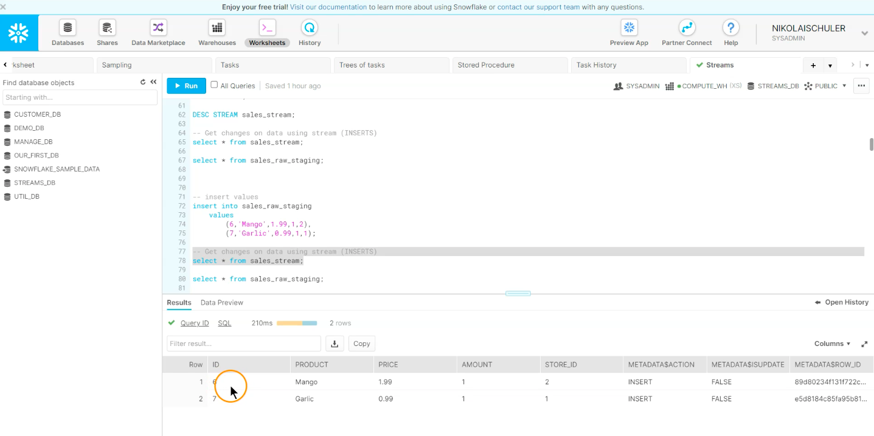
Streams - INSERT

Slide 22
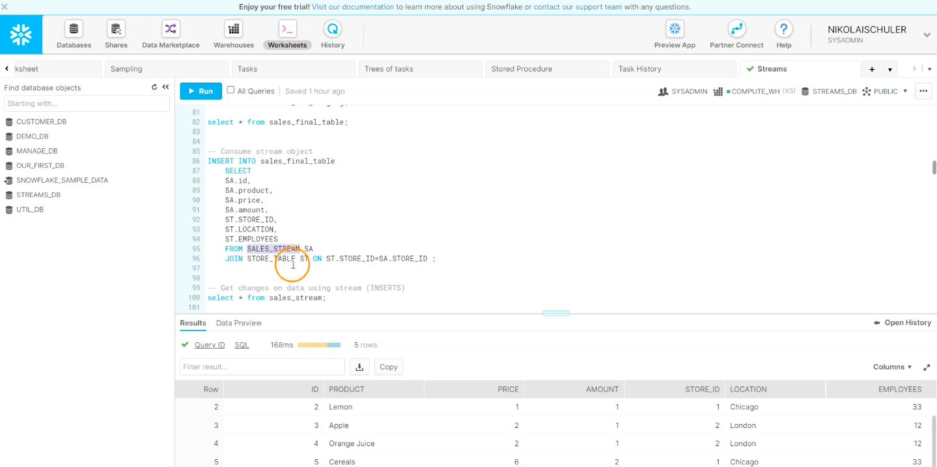
Streams - INSERT

Slide 23
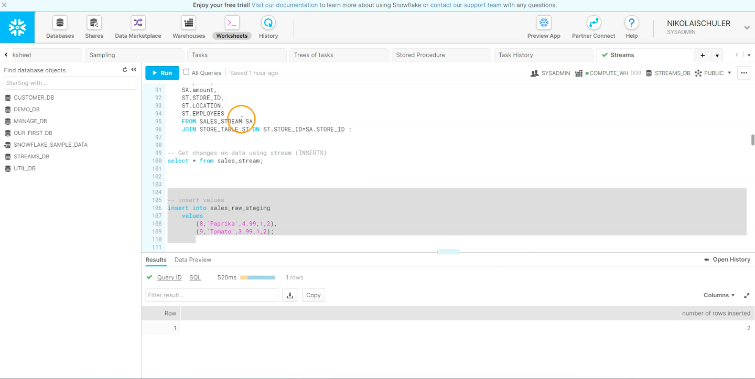
Streams - INSERT

Slide 24
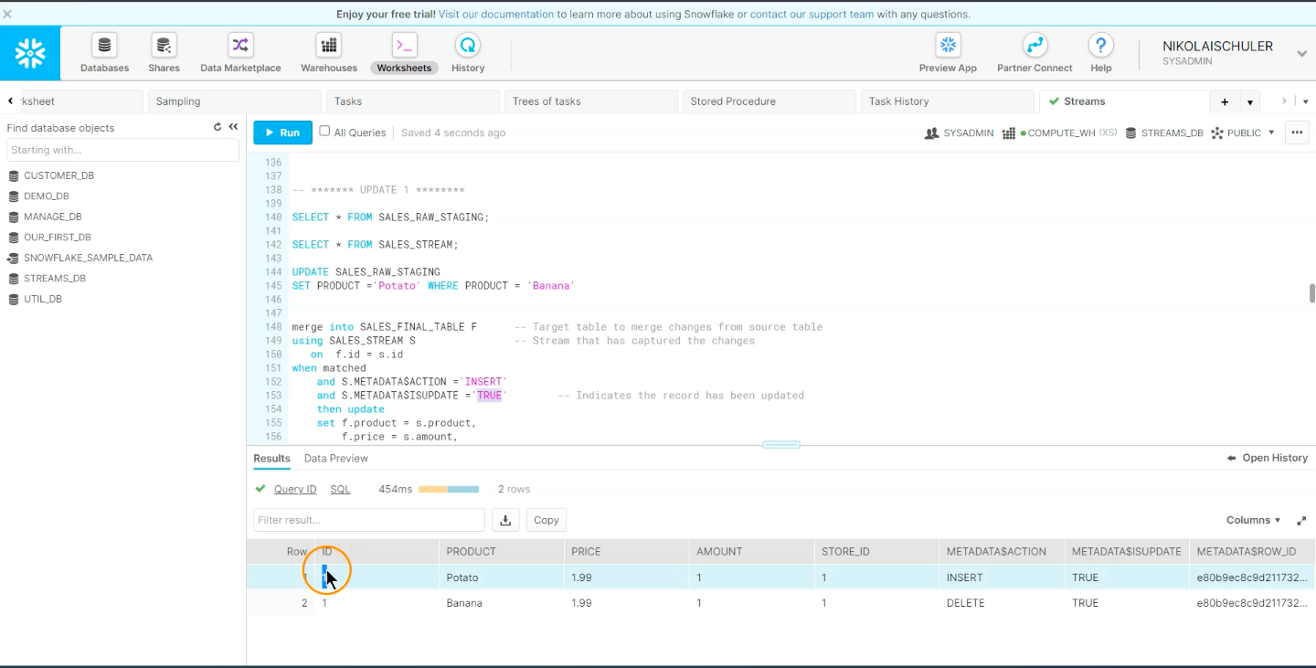
Streams - UPDATE

Slide 25
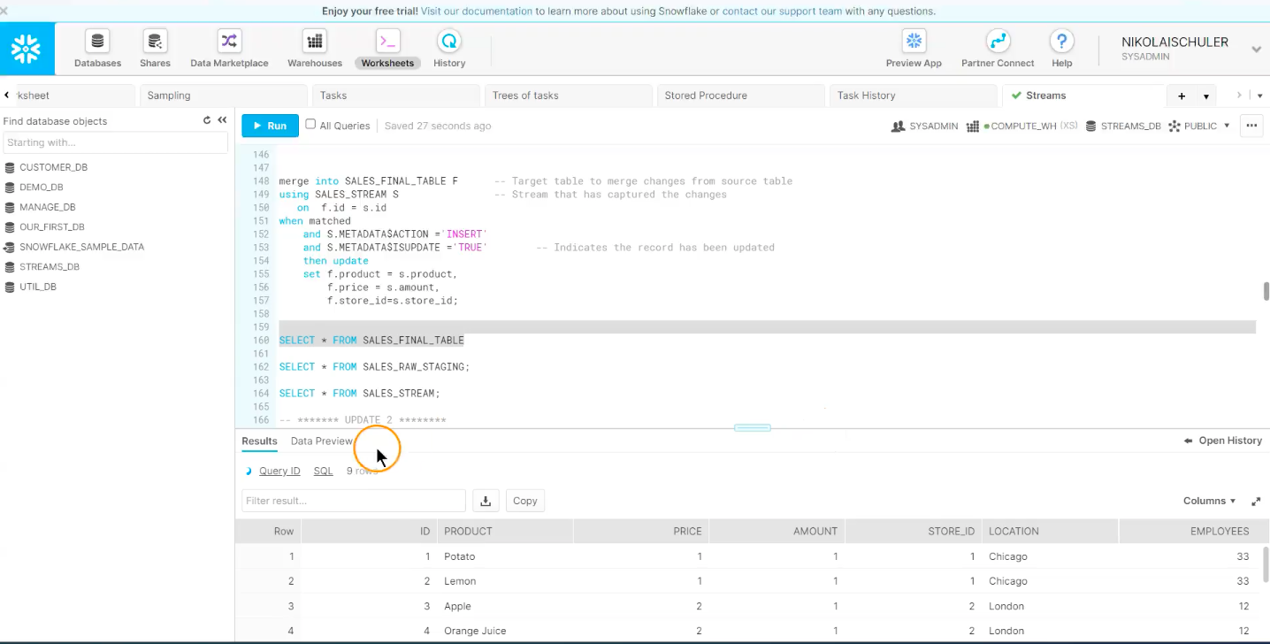
Streams - UPDATE

Slide 26
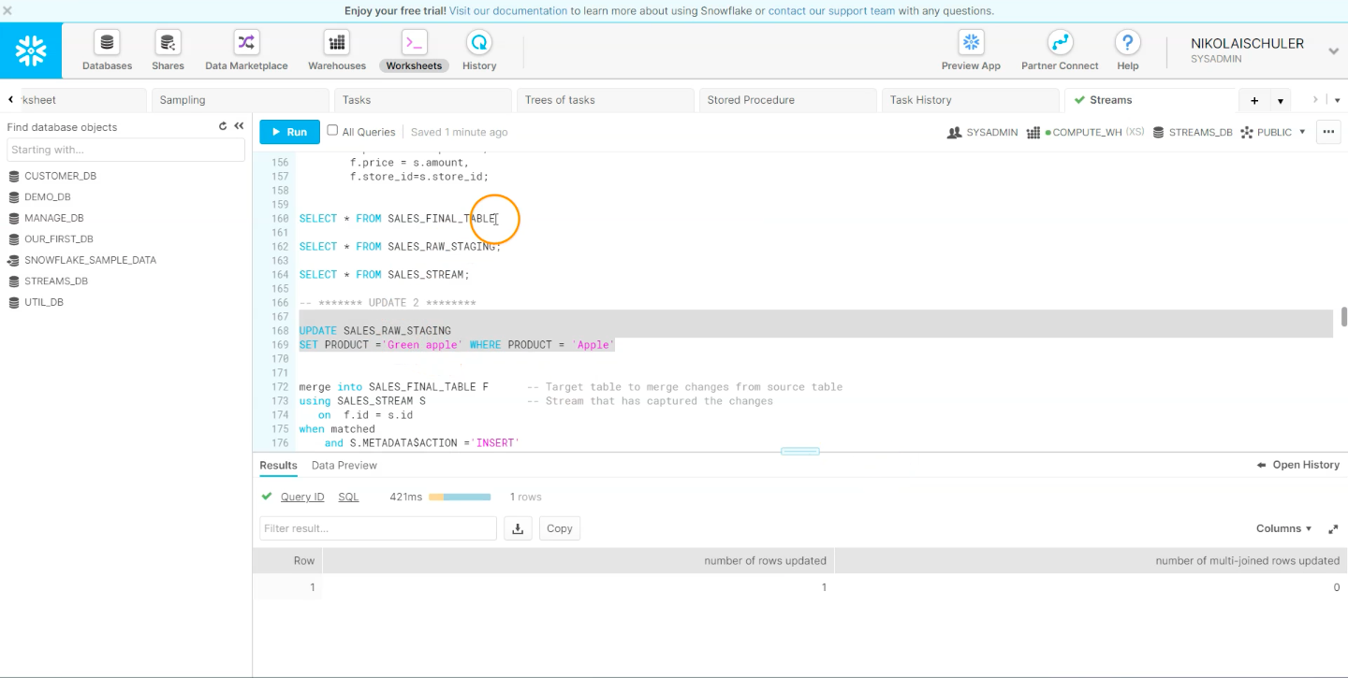
Streams - UPDATE

Slide 27
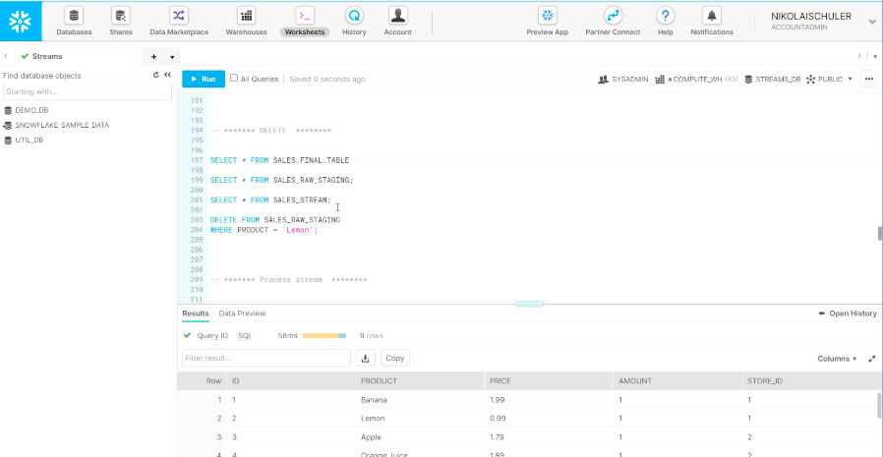
Streams - DELETE

Slide 28
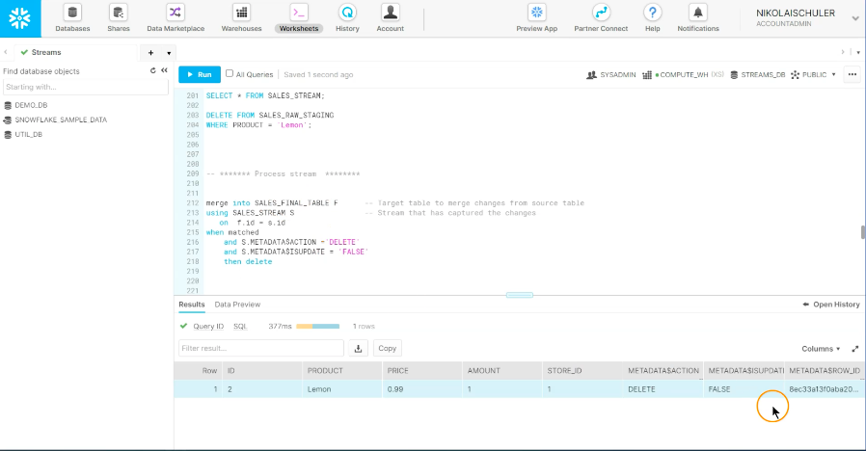
Streams - DELETE

Slide 29
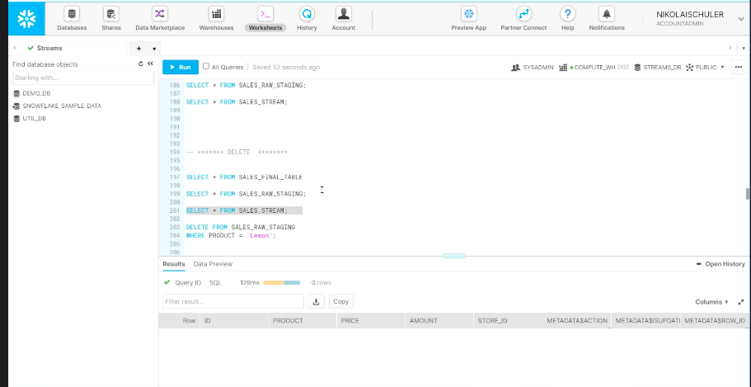
Streams - DELETE

Slide 30
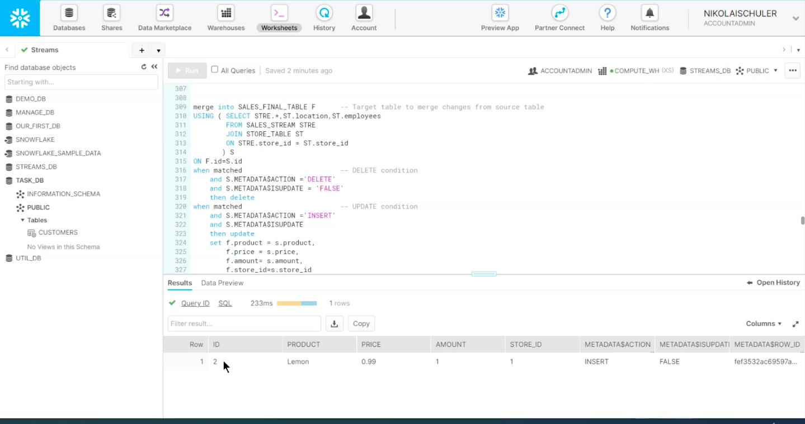
Streams - Combining All Data Changes

Slide 31
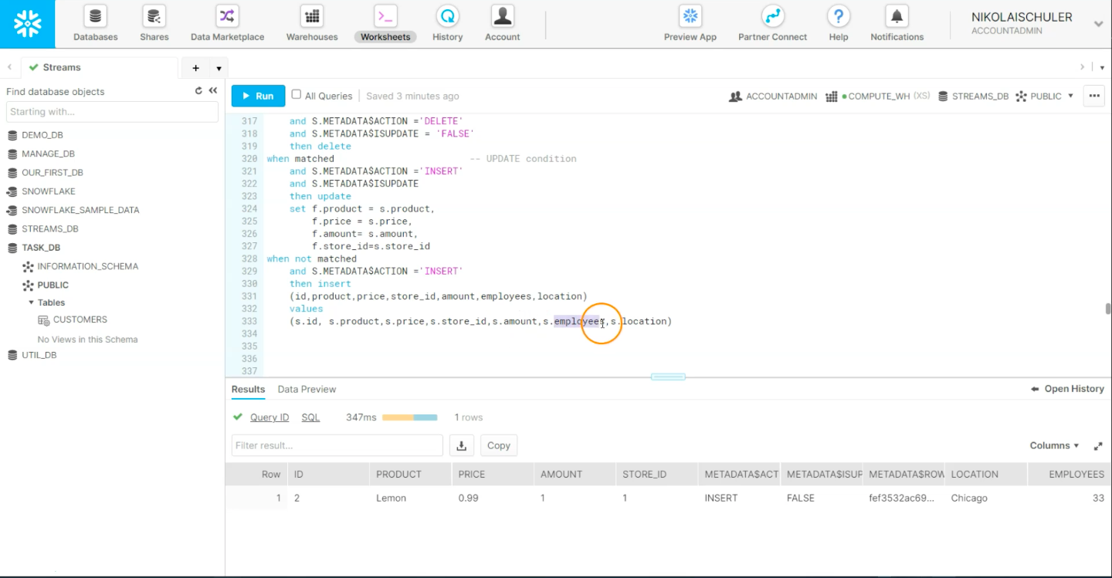
Streams - Combining All Data Changes

Slide 32
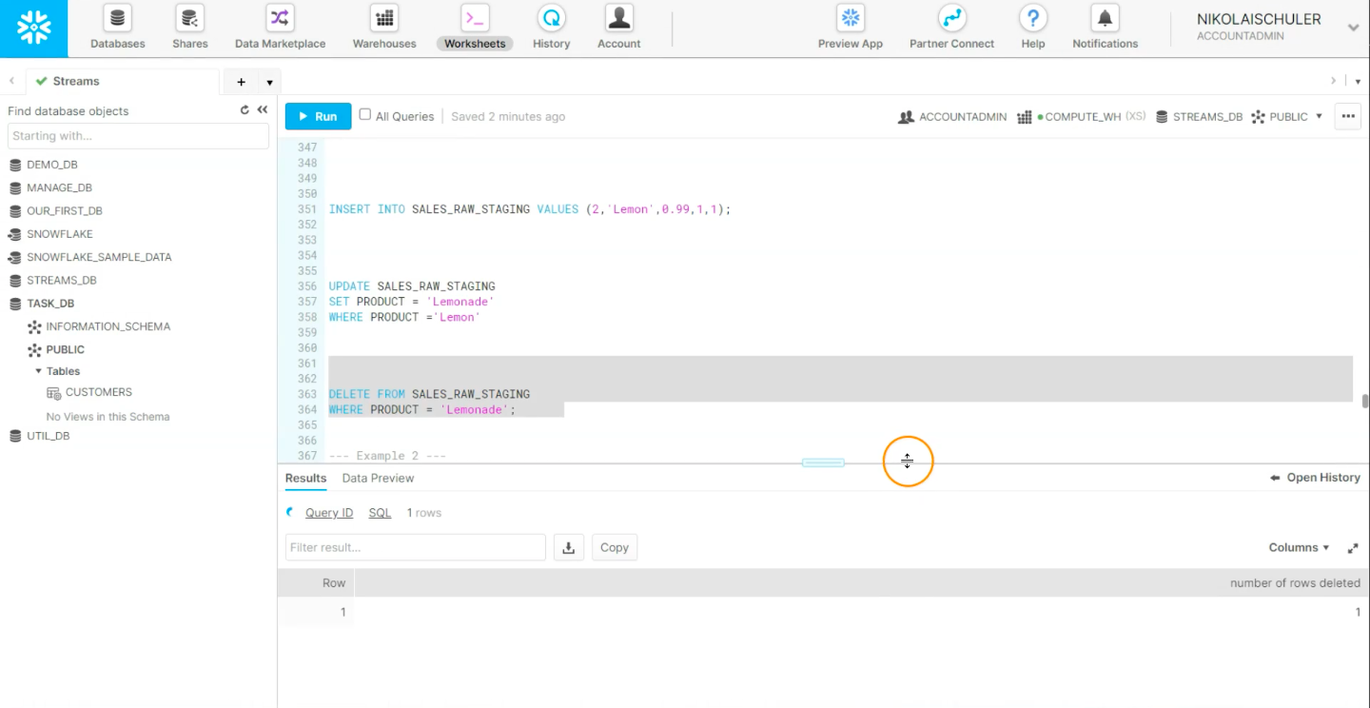
Streams - Combining All Data Changes

Slide 33
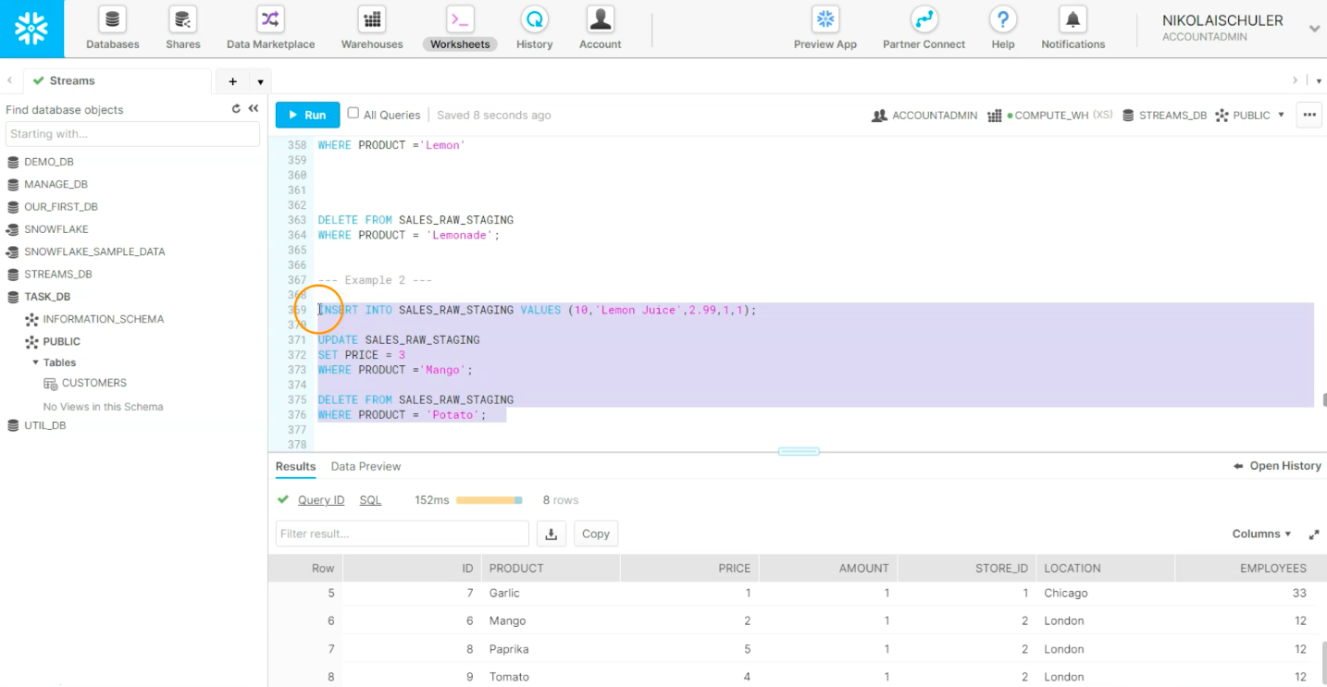
Streams - Combining All Data Changes

Slide 34
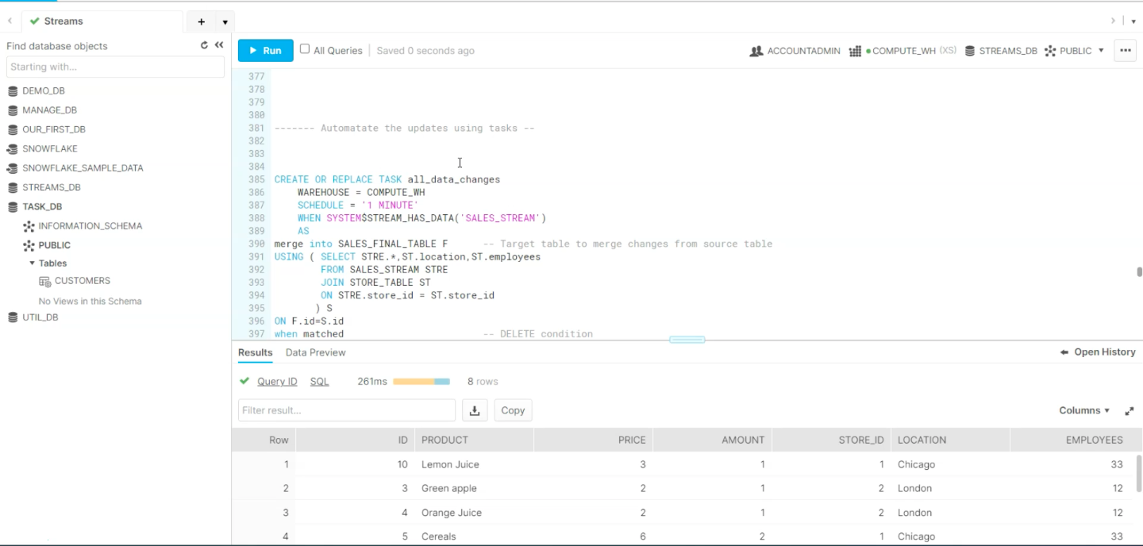
Streams - Combining Streams & Tasks

Slide 35
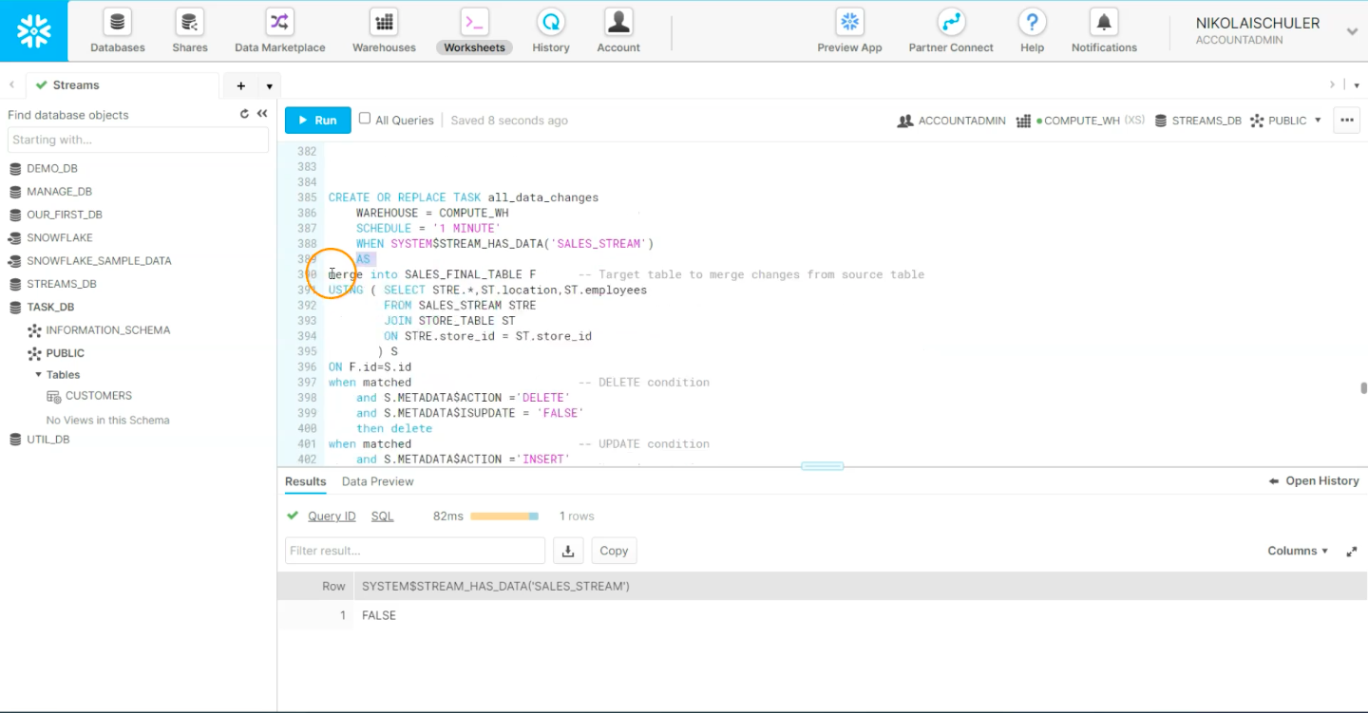
Streams - Combining Streams & Tasks

Slide 36
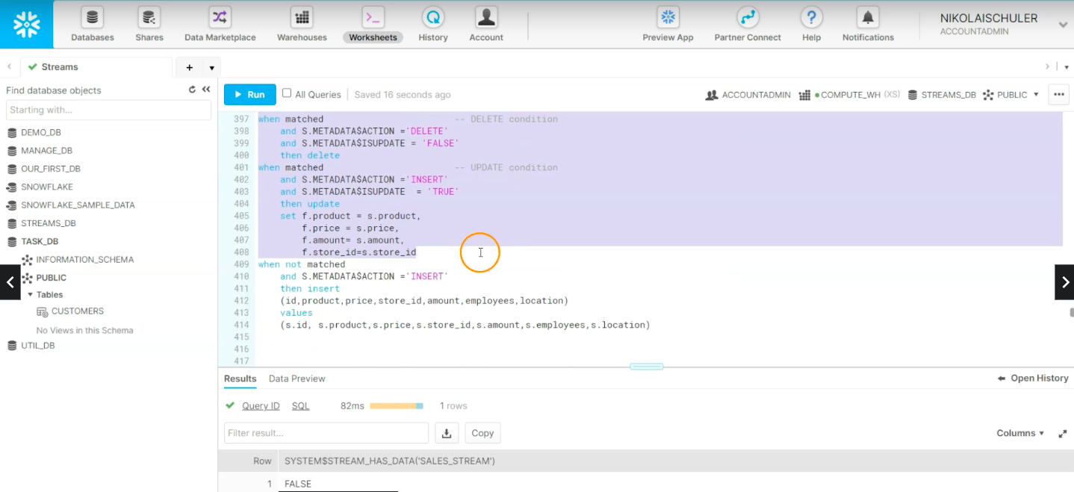
Streams - Combining Streams & Tasks

Slide 37
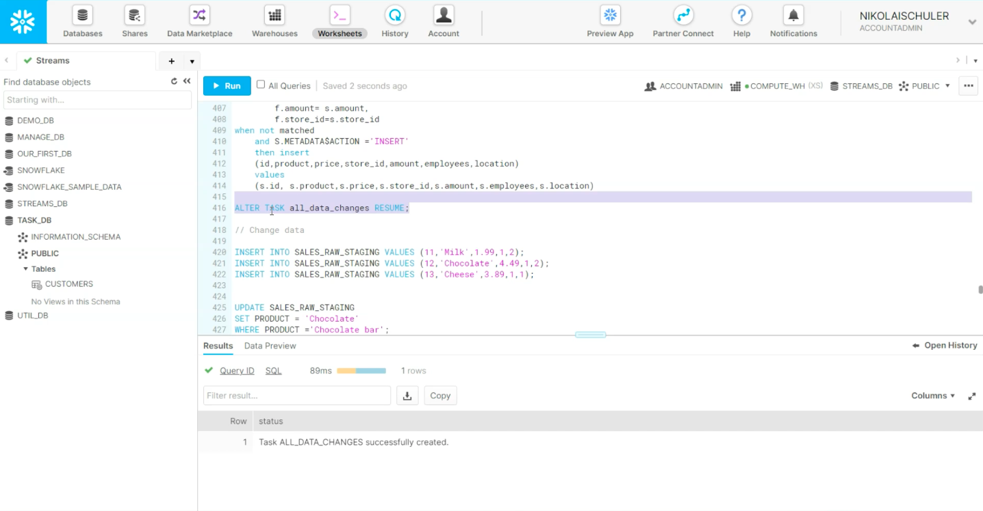
Streams - Combining Streams & Tasks

Slide 38
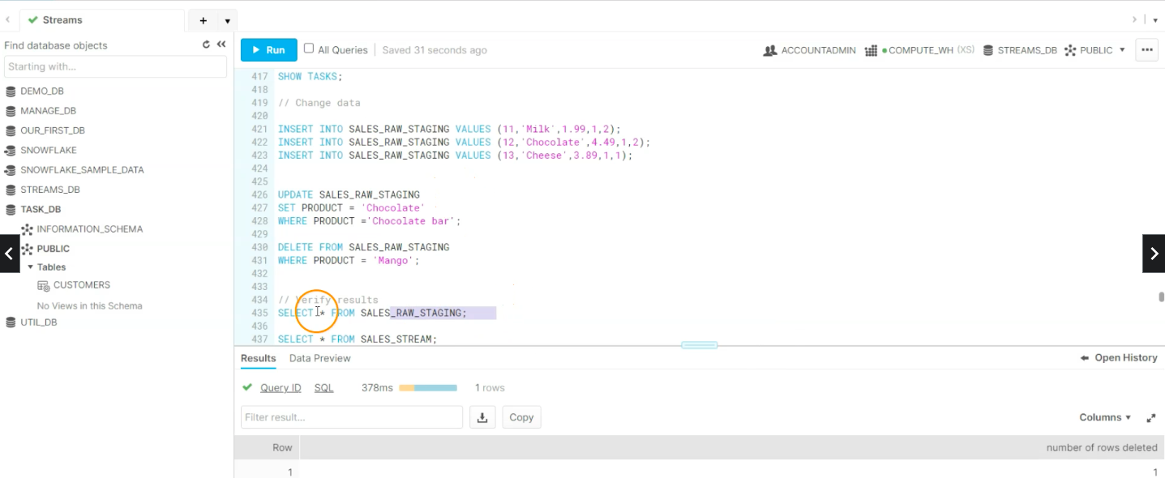
Streams - Combining Streams & Tasks

Slide 39
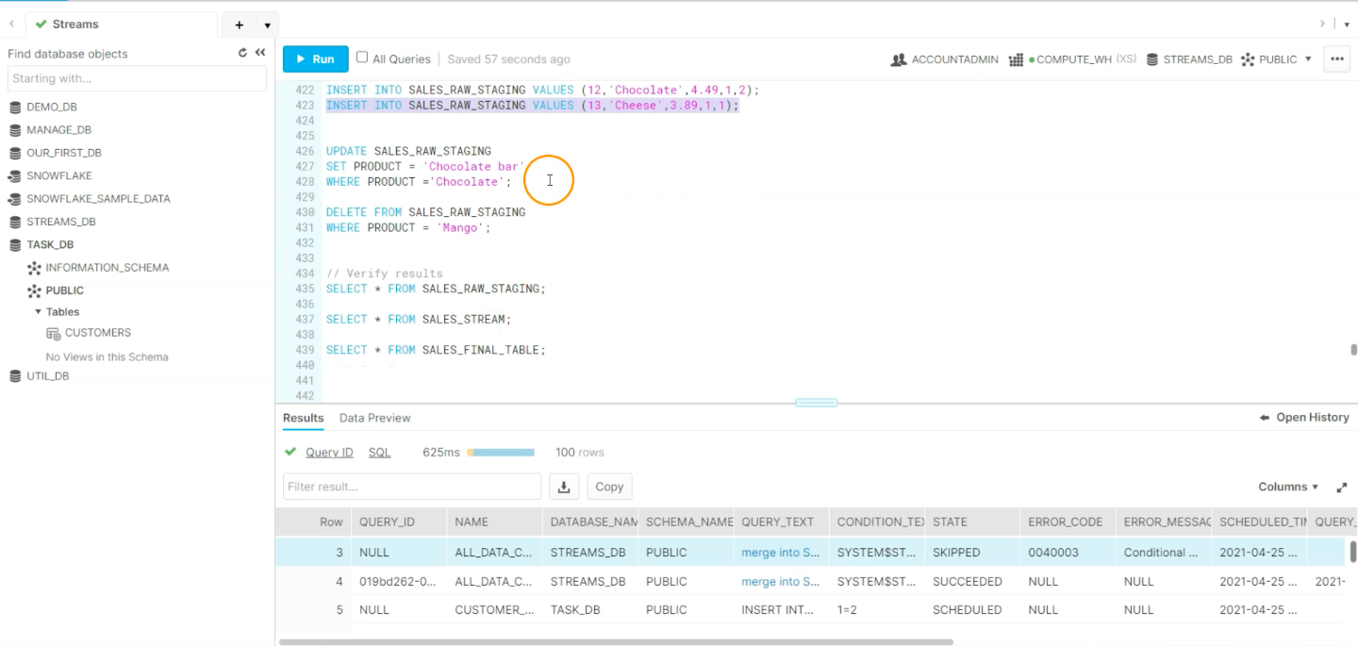
Streams - Combining Streams & Tasks

Slide 40


Slide 41
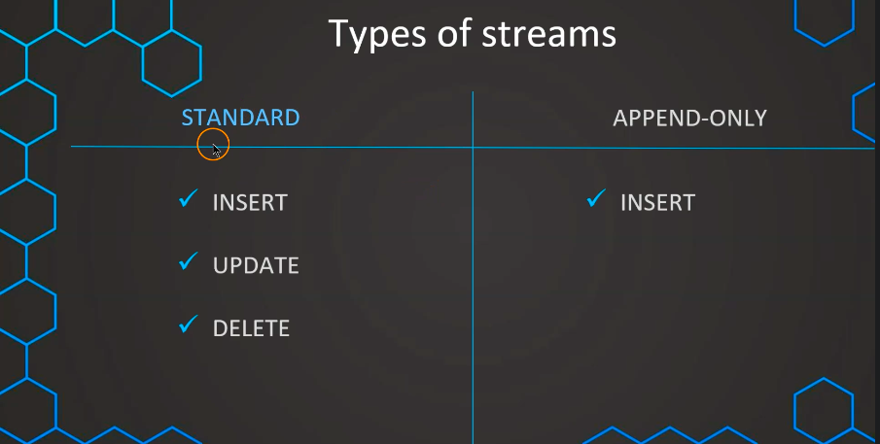

Slide 42
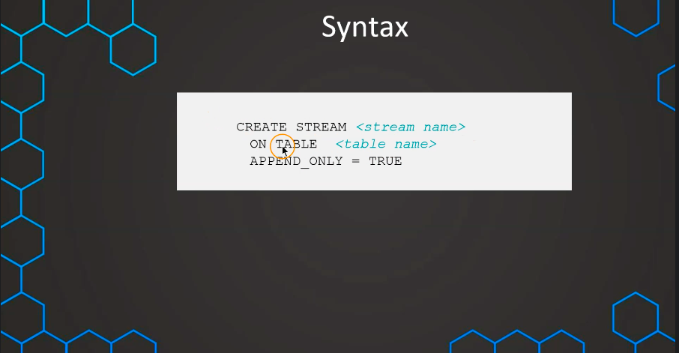

Slide 43
